Slide 1
Exploring Deep rl algorithms
Anamika Singh
Sannihith Kilaru
CSE 546 Reinforcement Learning
University at Buffalo
December 4, 2022

Slide 2

Topics for Discussion
Environment
Implementation
Reward Shaping
Results
Summary
Contribution

Slide 3
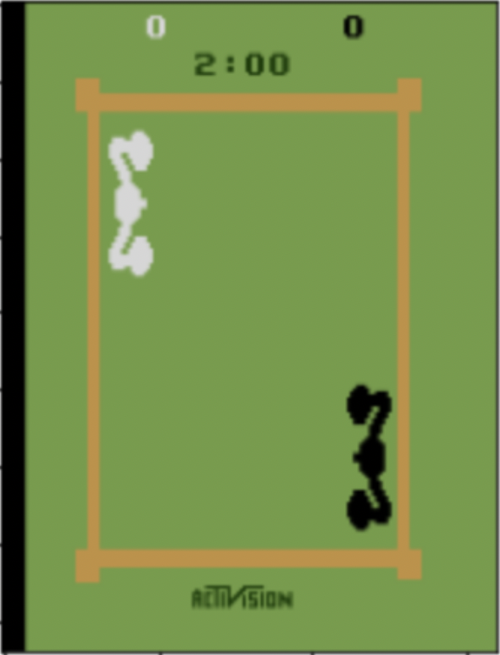
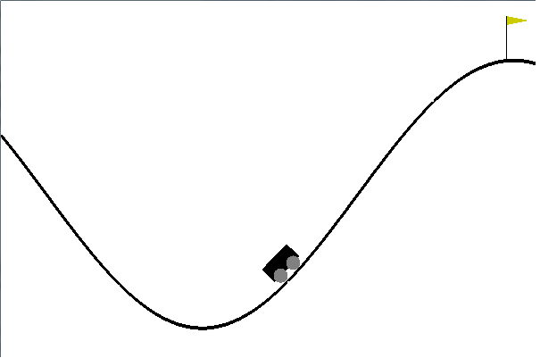
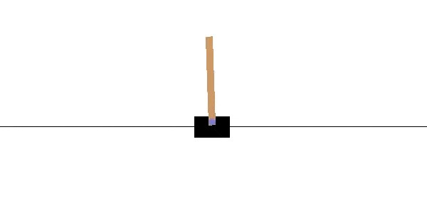
Environments
Cartpole
MountainCar
Boxing

Slide 4
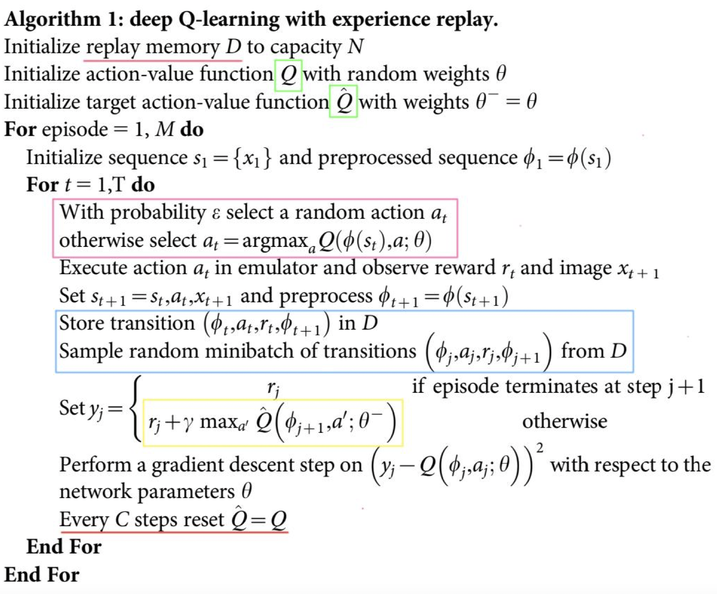
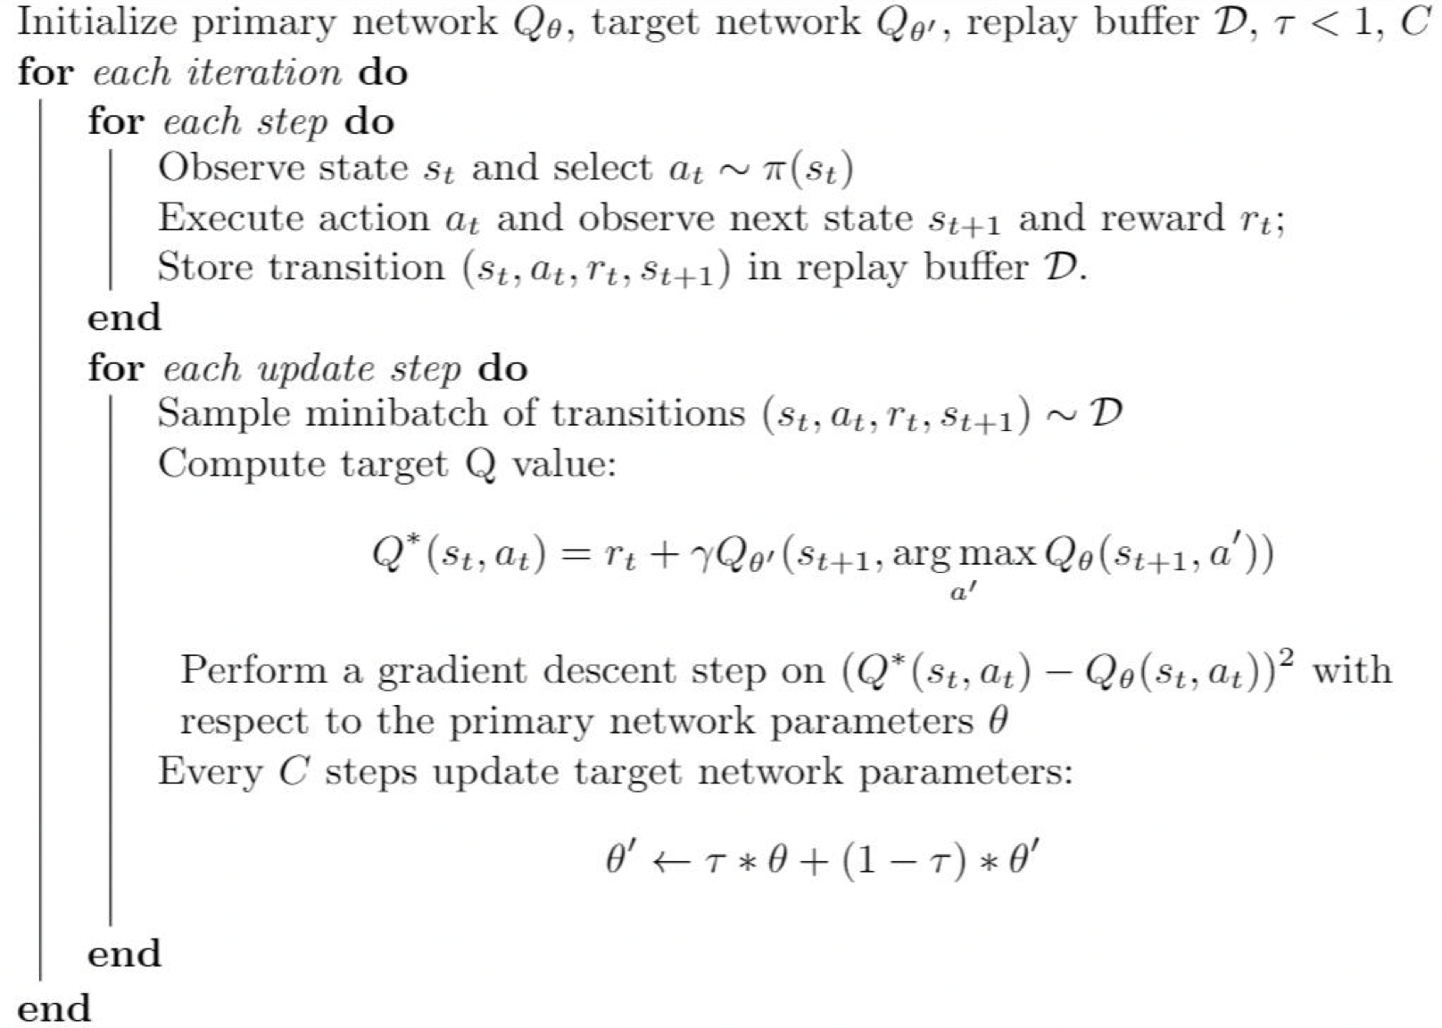
Implementation
DQN
Double DQN

Slide 5
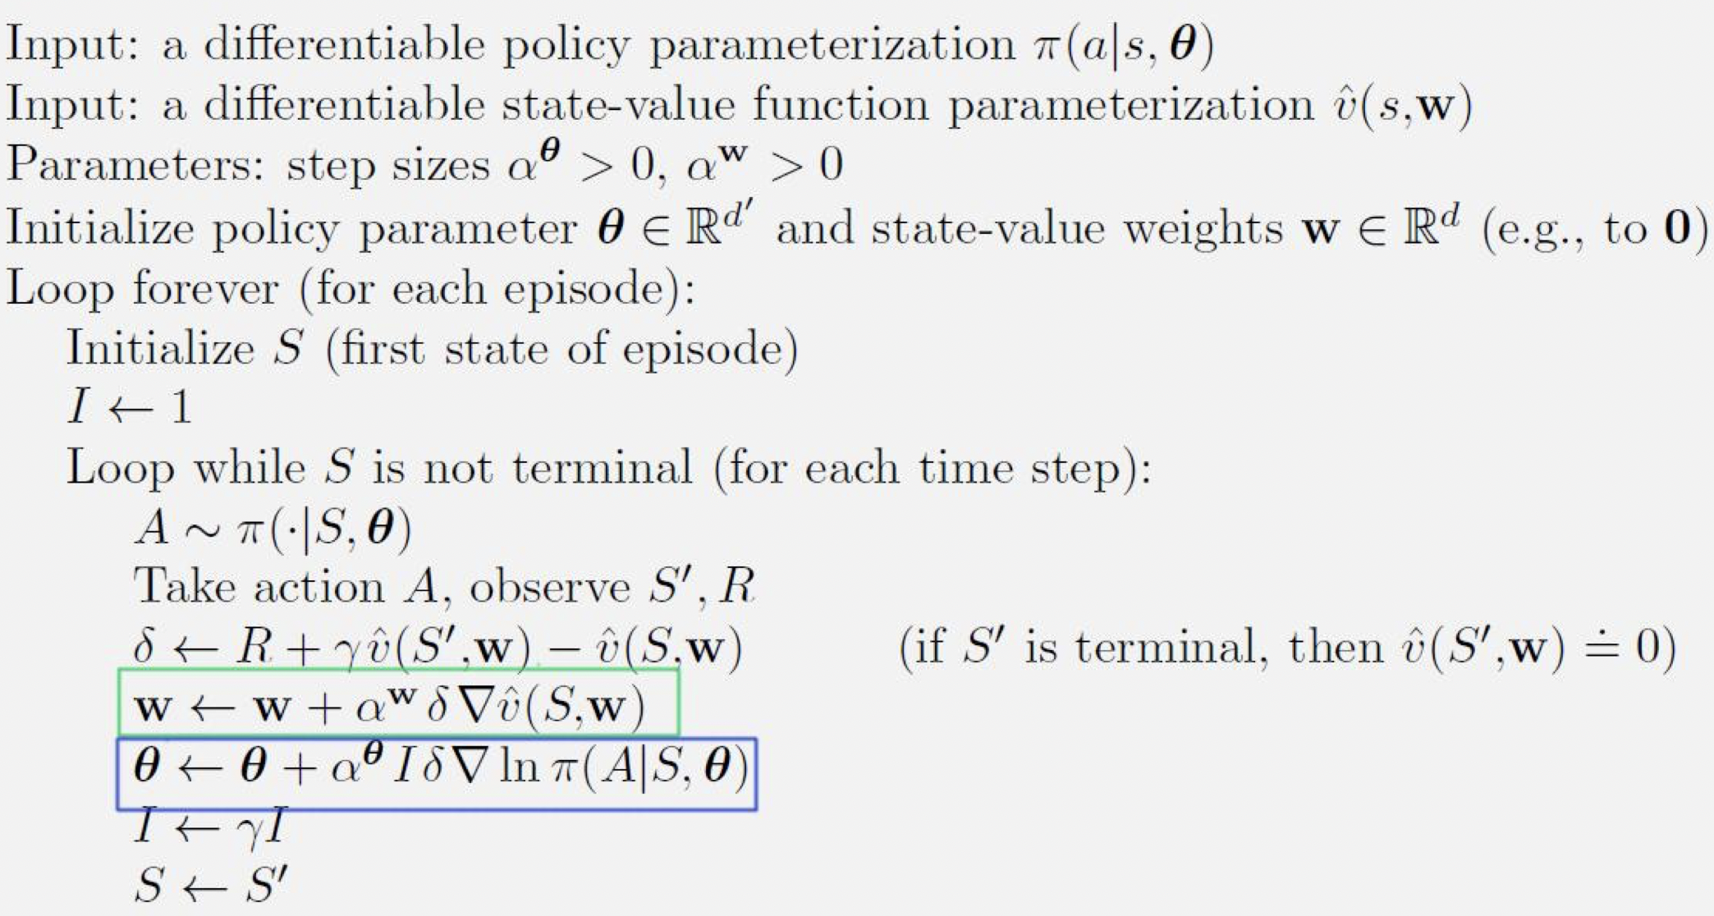
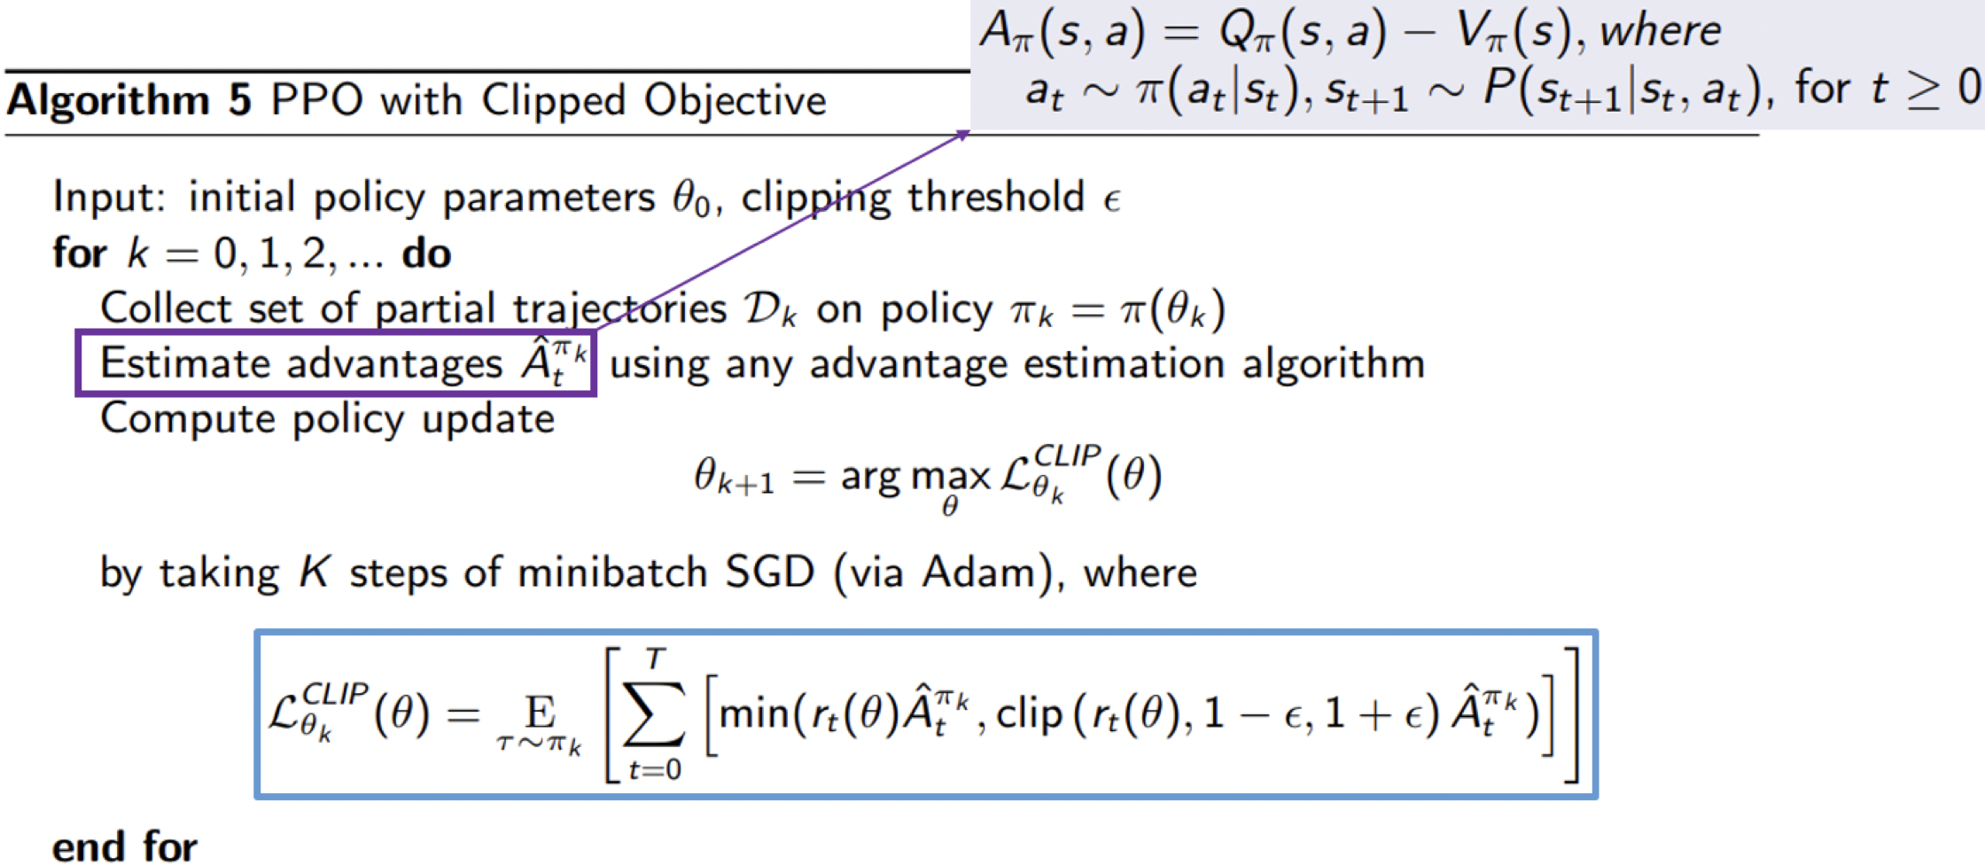
Implementation
A2C
PPO

Slide 6
Reward Shaping
Cartpole
MountainCar
reward = 100*((math.sin(3*next_state[0]) * 0.0025 + 0.5 * next_state[1] * next_state[1])-(math.sin(3*state[0]) * 0.0025 + 0.5 * state[1] * state[1]))

Slide 7
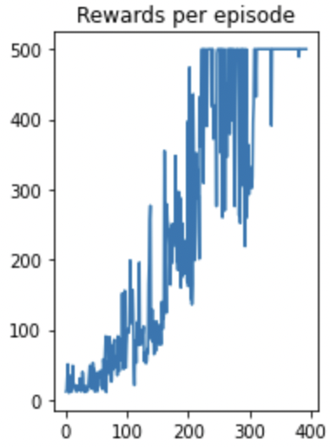
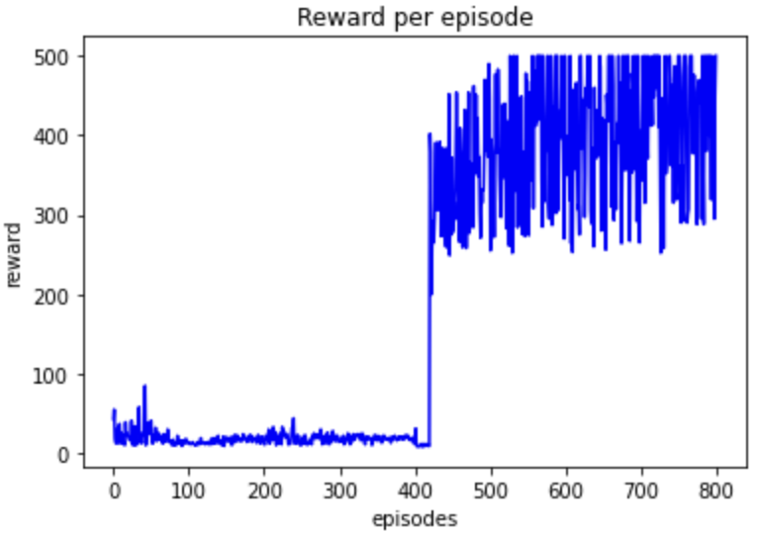
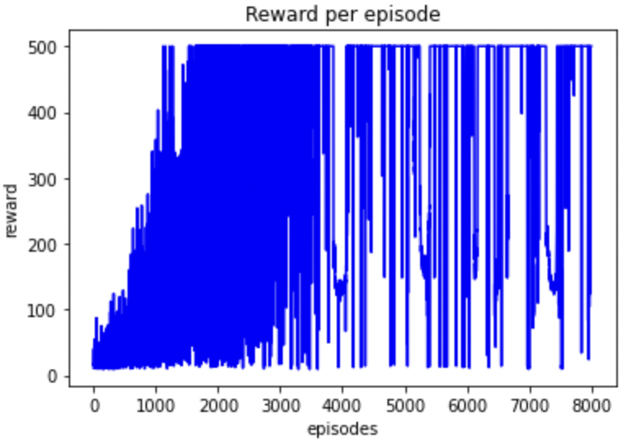
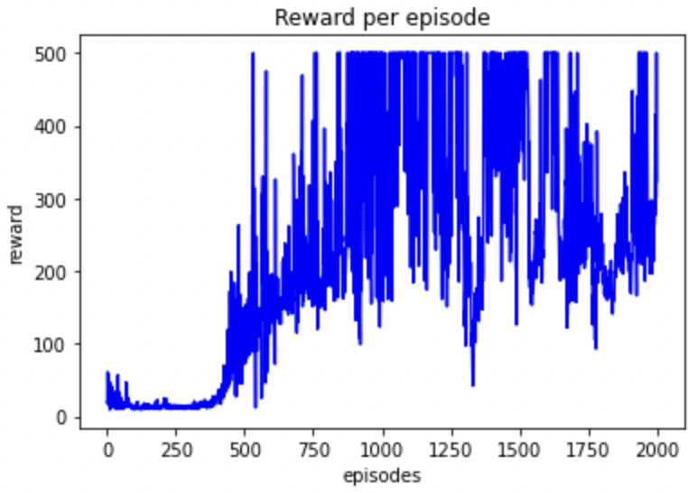
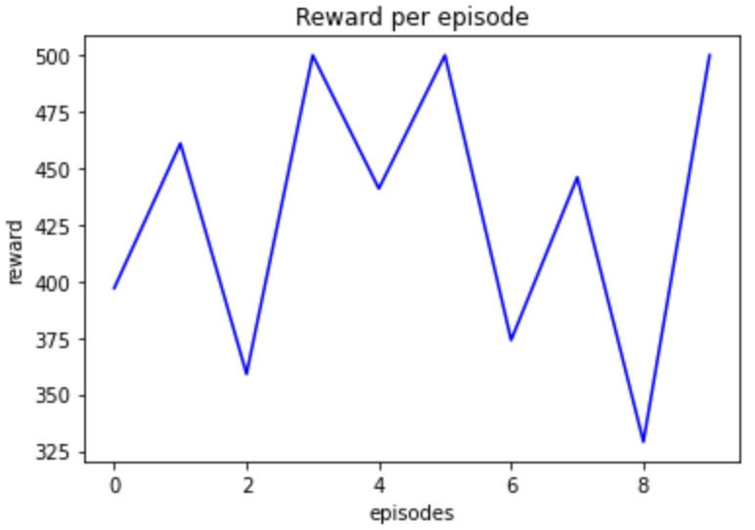
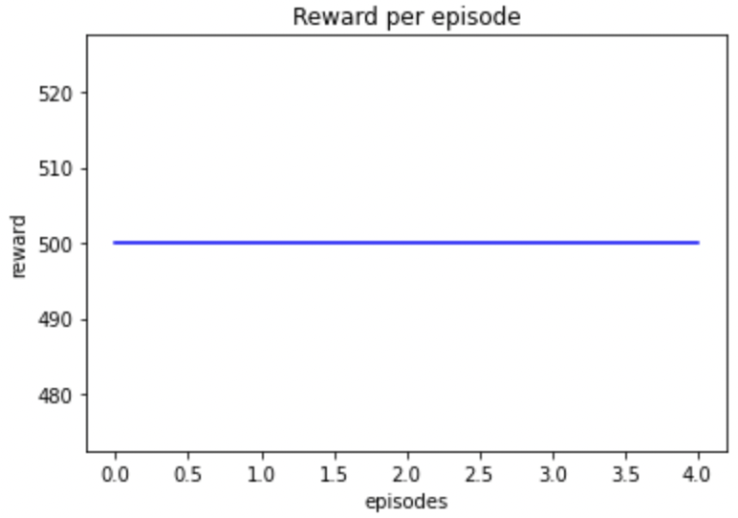
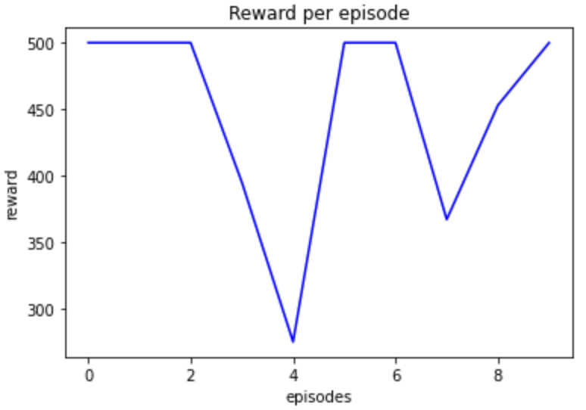
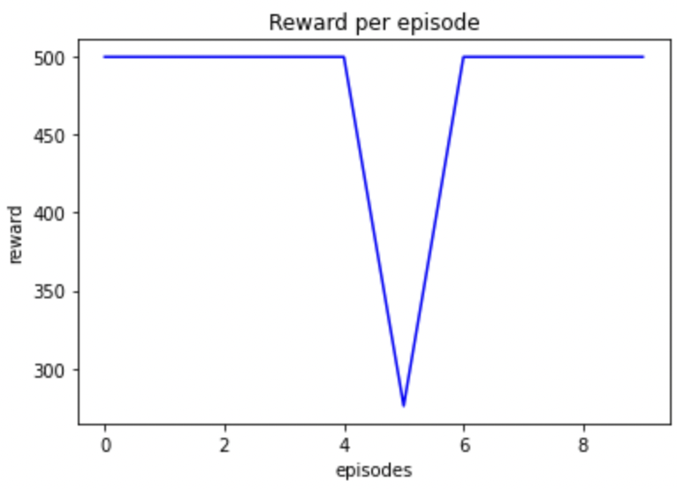
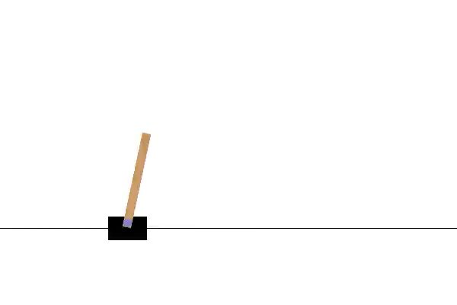
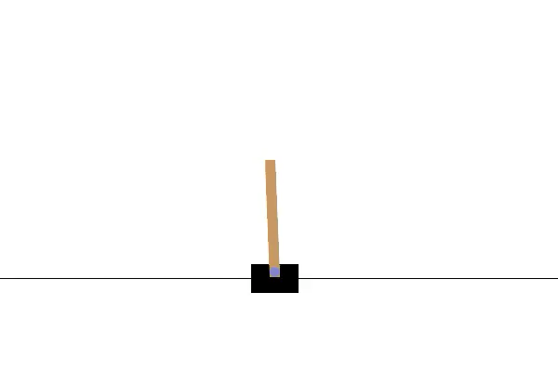
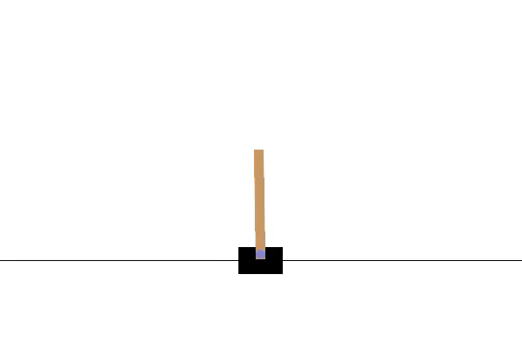
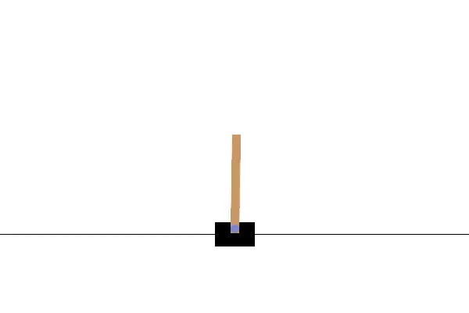
Cartpole
DQN
Double DQN
A2C
PPO

Slide 8
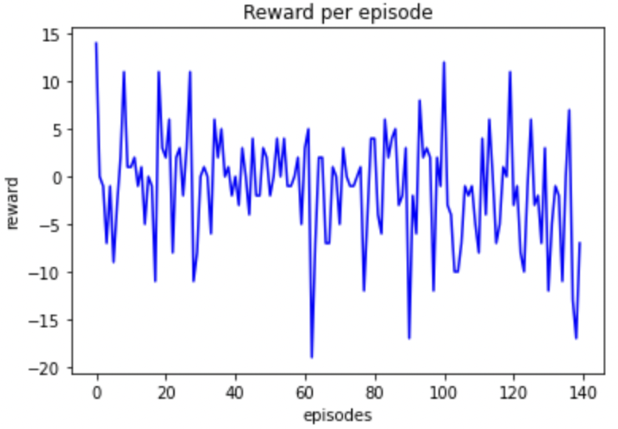
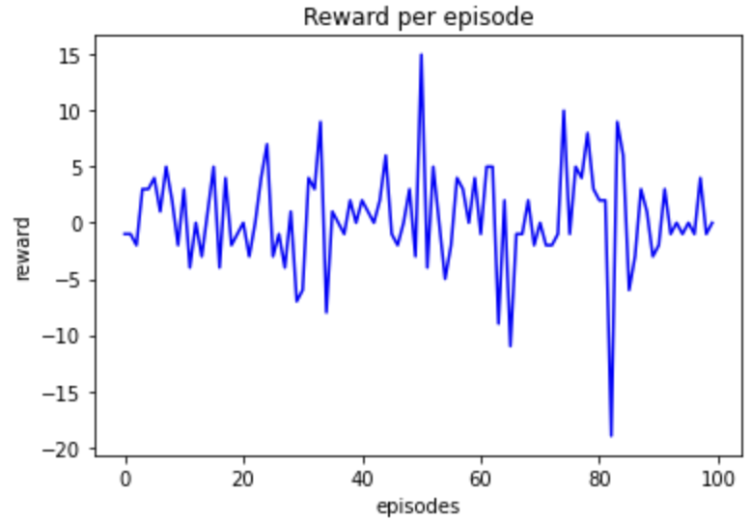
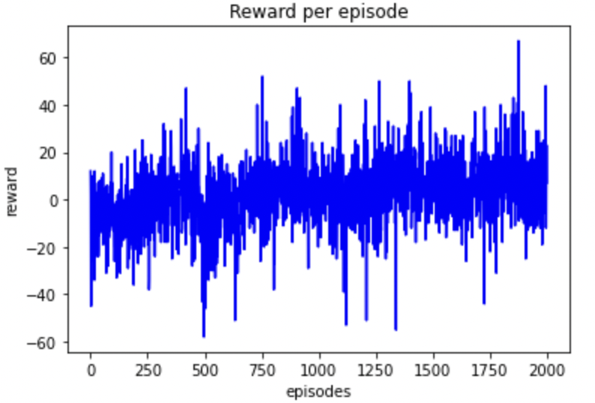
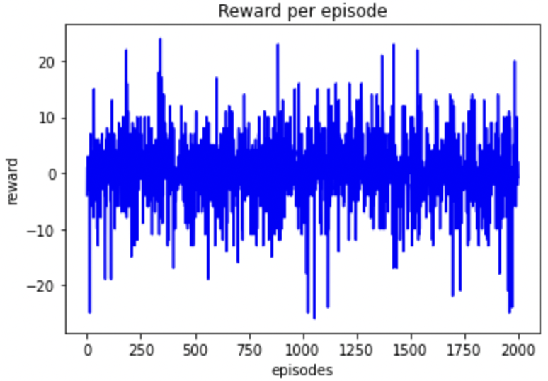
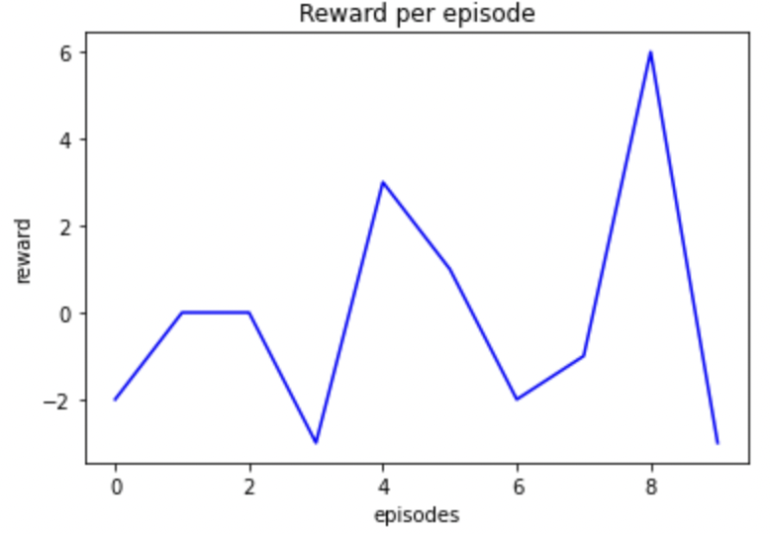
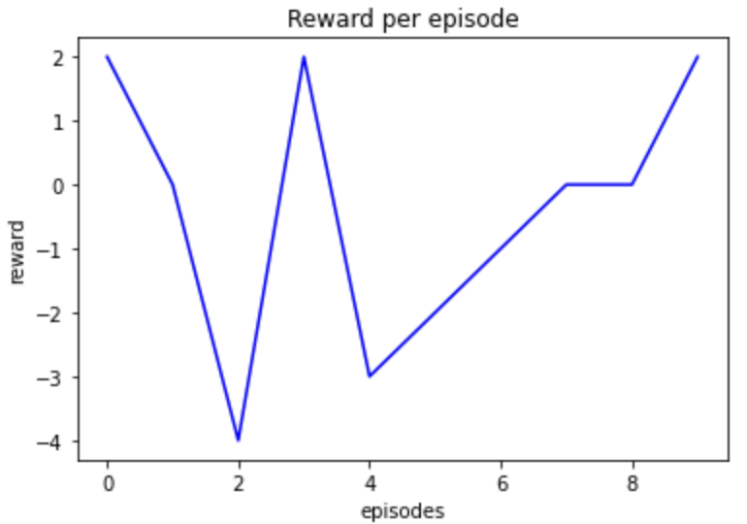
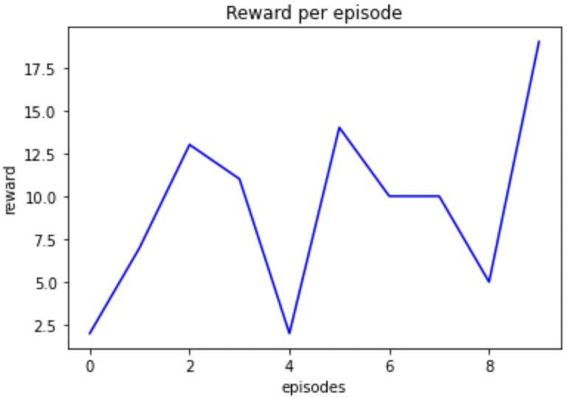
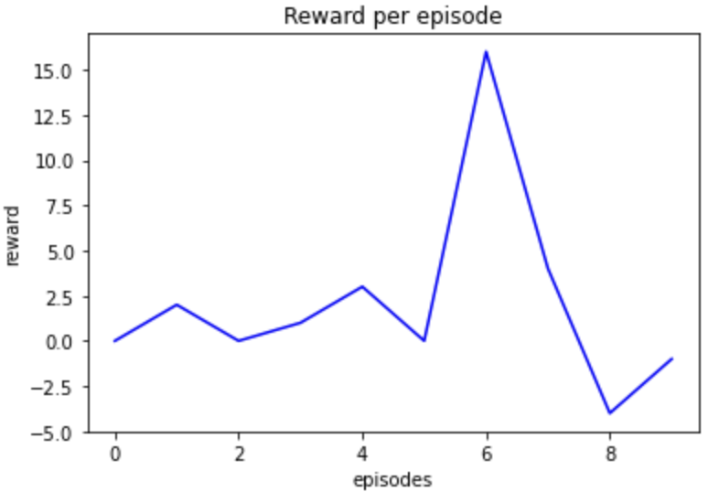
Boxing
DQN
Double DQN
A2C
PPO

Slide 9
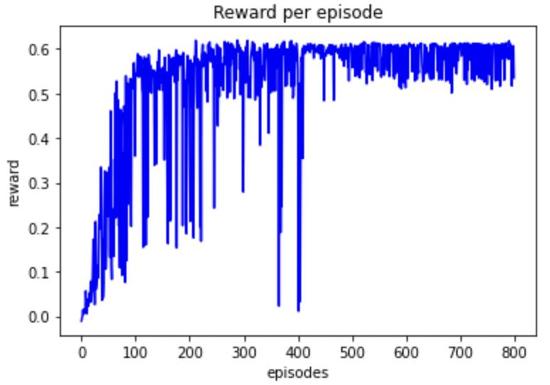
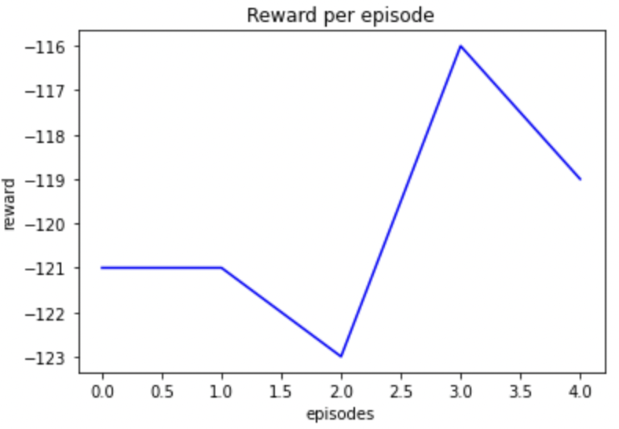
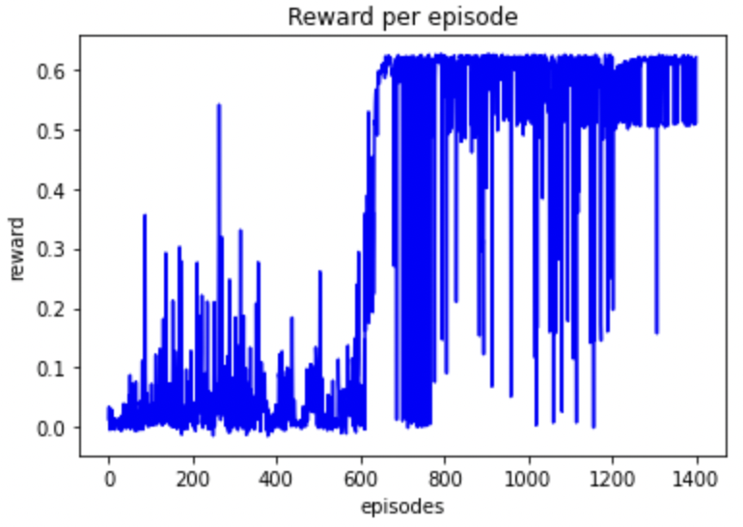
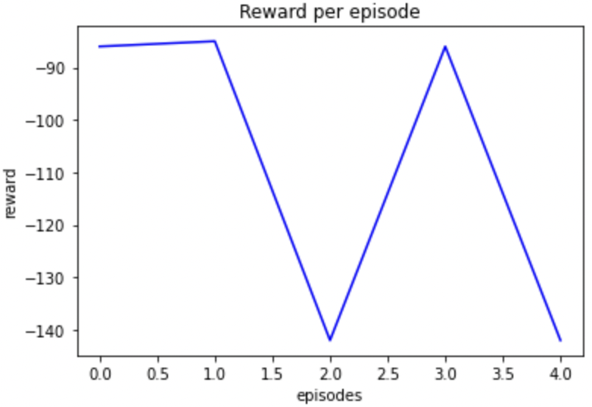
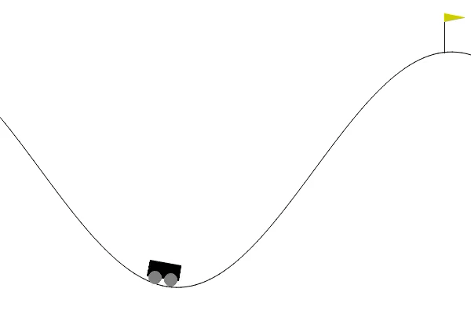
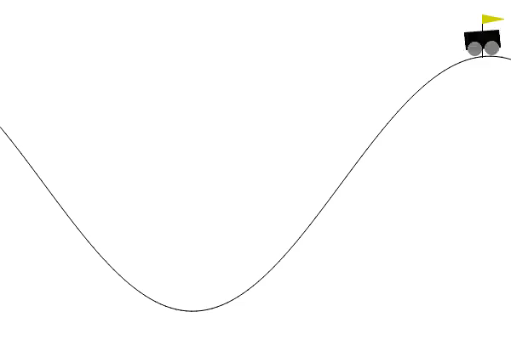
MountainCar
DQN
Double DQN

Slide 10
Summary
For CartPole the A2C gave the best results.
For Boxing actor critic methods gave better results than value-based methods.
For MountainCar DQN performed better than DDQN.
Reward shaping helped in convergence and reduction in training time for Cart Pole and Mountain Car environments.

Slide 11
Contribution
Team member | Final project part | Contribution
sannihit | DQN, DDQN, A2C, PPO | 50%
singh27 | DQN, DDQN, A2C, PPO | 50%

